Slide 1

funded by the
Australian Government
Department of Health
to deliver the
National Aged Care Advocacy Program

Slide 2
OPAN was established in 2016-17
The formation of OPAN brings together the nine service delivery organisation (SDOs) that have been successfully delivering advocacy, information and education services to older people in metropolitan, regional, rural and remote locations, for over 25 years.
The knowledge, expertise, relationships and reach that OPAN has developed over this period is without peer.

Slide 3
OPAN’s vision
OPAN’s vision is to become the single, effective, standardised entity that drives the future of high quality aged advocacy information and education services within Australia.

Slide 4
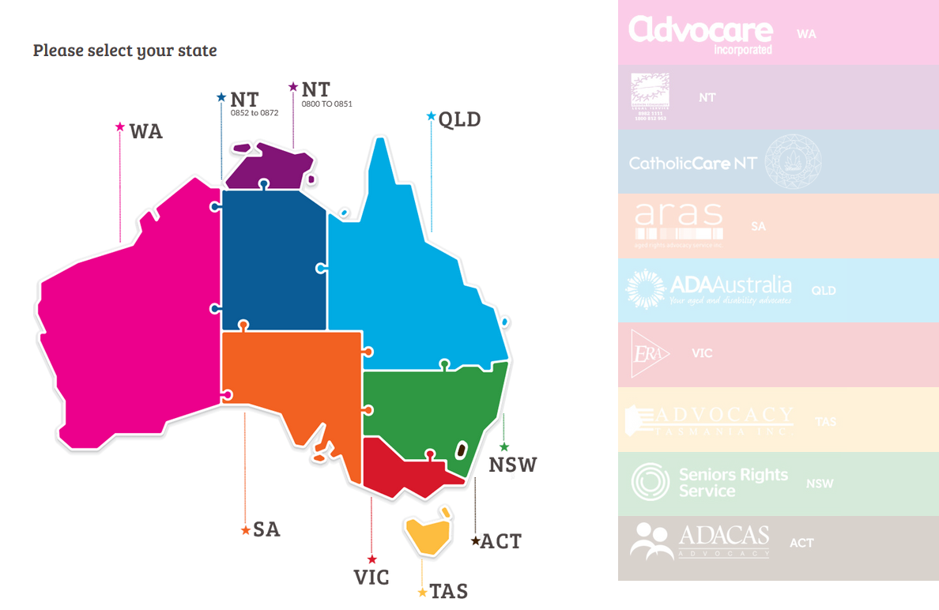
State and Territory service delivery organisations
In every state and territory – all accessible by calling 1800 700 600

Slide 5
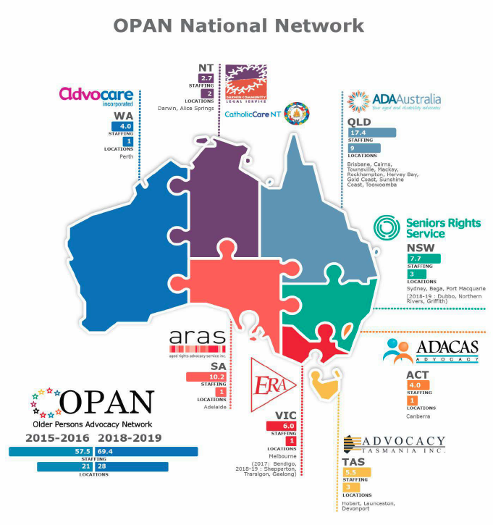

Slide 6
What is the National Aged Care Advocacy Program?
The National Aged Care Advocacy Program (NACAP) is funded by the Australian Government under the Aged Care Act 1997.
It provides free, independent and confidential advocacy support, education and information to older people (and their representatives) receiving, or seeking to receive, Australian Government funded aged care services.
Both residential care and community aged care are covered.

Slide 7
What is Advocacy?
Advocacy is the process of standing beside someone and supporting them to:
understand and exercise their rights
have their voice heard on the issues that are important to them.

Slide 8
What is an Advocate?
An advocate is an impartial person, who will:
take the time to listen to you and understand your views and wishes
inform you of a rights and responsibilities
assist you to explore your options
support you to make informed decisions

Slide 9
What is an Advocate?
An advocate is an impartial person, who will:
provide practical assistance such as help to write a letter or raise your concerns at a meeting
speak for you in situations where you don’t feel able to speak for yourself
increase your capacity to self-advocate
have you voice heard on the issues that are important to you.

Slide 10
What are aged care advocacy services?
Advocacy services ensure that the rights of consumers are supported, and that they are empowered to make informed decisions about their care.
Advocacy services can support a consumer to engage with their aged care service and/or can engage with the service on behalf of the consumer if requested.

Slide 11
Who can access advocacy services?
Anyone who:
lives in a nursing home or hostel
receives a community aged care package (support at home)
receives flexible care
has been assessed by an Aged Care Assessment Team (ACAT)
used to receive aged care services or
is representing the interests of the person receiving aged care services

Slide 12
NACAP aims to provide free, independent, confidential advocacy support to older people, their families and representatives, to ensure they:
can effectively interact with the aged care system
can better transition between aged care services
are enabled and empowered to make informed decisions about the care they receive
can exercise their right to choice in accessing and receiving aged care services

Slide 13
NACAP aims to provide free, independent, confidential advocacy support to older people, their families and representatives, to ensure they:
have their aged care rights better understood, recognised and upheld
have their aged care needs more optimally met due to the intervention of advocacy support
are better informed about the care options available to them
are supported to increase their capacity to self-advocate
are supported to resolve problems or complaints with their aged care provider in relation to the aged care services they receive

Slide 14
NACAP aims to provide free, independent, confidential advocacy support to older people, their families and representatives, to ensure they:
are supported with information and advice about their care rights and responsibilities
are supported to respond to elder abuse within the aged care system
are supported to address issues that impact their ability to live in their own homes, with the aim of preventing premature admission to aged care facilities and focussing on wellness and reablement.

Slide 15
NACAP provides free, education sessions to older people’s organisations, and to service providers
groups of people receiving Commonwealth funded aged care services in their home or retirement village
people residing in residential aged care, often at resident meetings
Community-based respite groups
support groups such as those for carers, pain, dementia and diabetes.
social interest groups such as Probus

Slide 16
NACAP draft framework
The Department of Health is in the process of revising the draft framework for the National Aged Care Advocacy Framework.
We understand the Minister for Aged Care will be releasing a revised draft for further public consultation in late November.
This will be the key guiding document for our work under the NACAP.

Slide 17
Some statistics
1.3 million people receive some sort of aged care support from the Federal government – expected to reach 3.5 million by 2050.
About 2,500 cases of reportable assault each year in aged care.
There are more than 45,000 older people from non-English speaking backgrounds in care.
Around 17,000 older people per year call for advocacy services.

Slide 18

Questions?
Lewis Kaplan
CEO, OPAN
Older Persons Advocacy Network
E: lewis.kaplan@opan.com.au
W: opan.com.au
T: 1800 700 600

